Slide 1
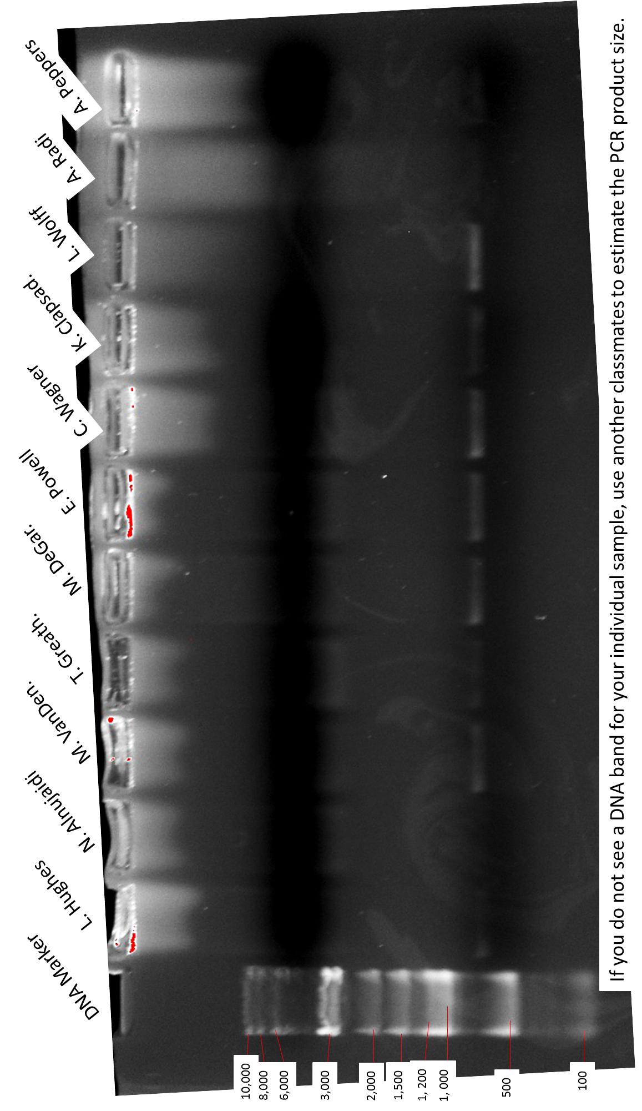

Slide 2
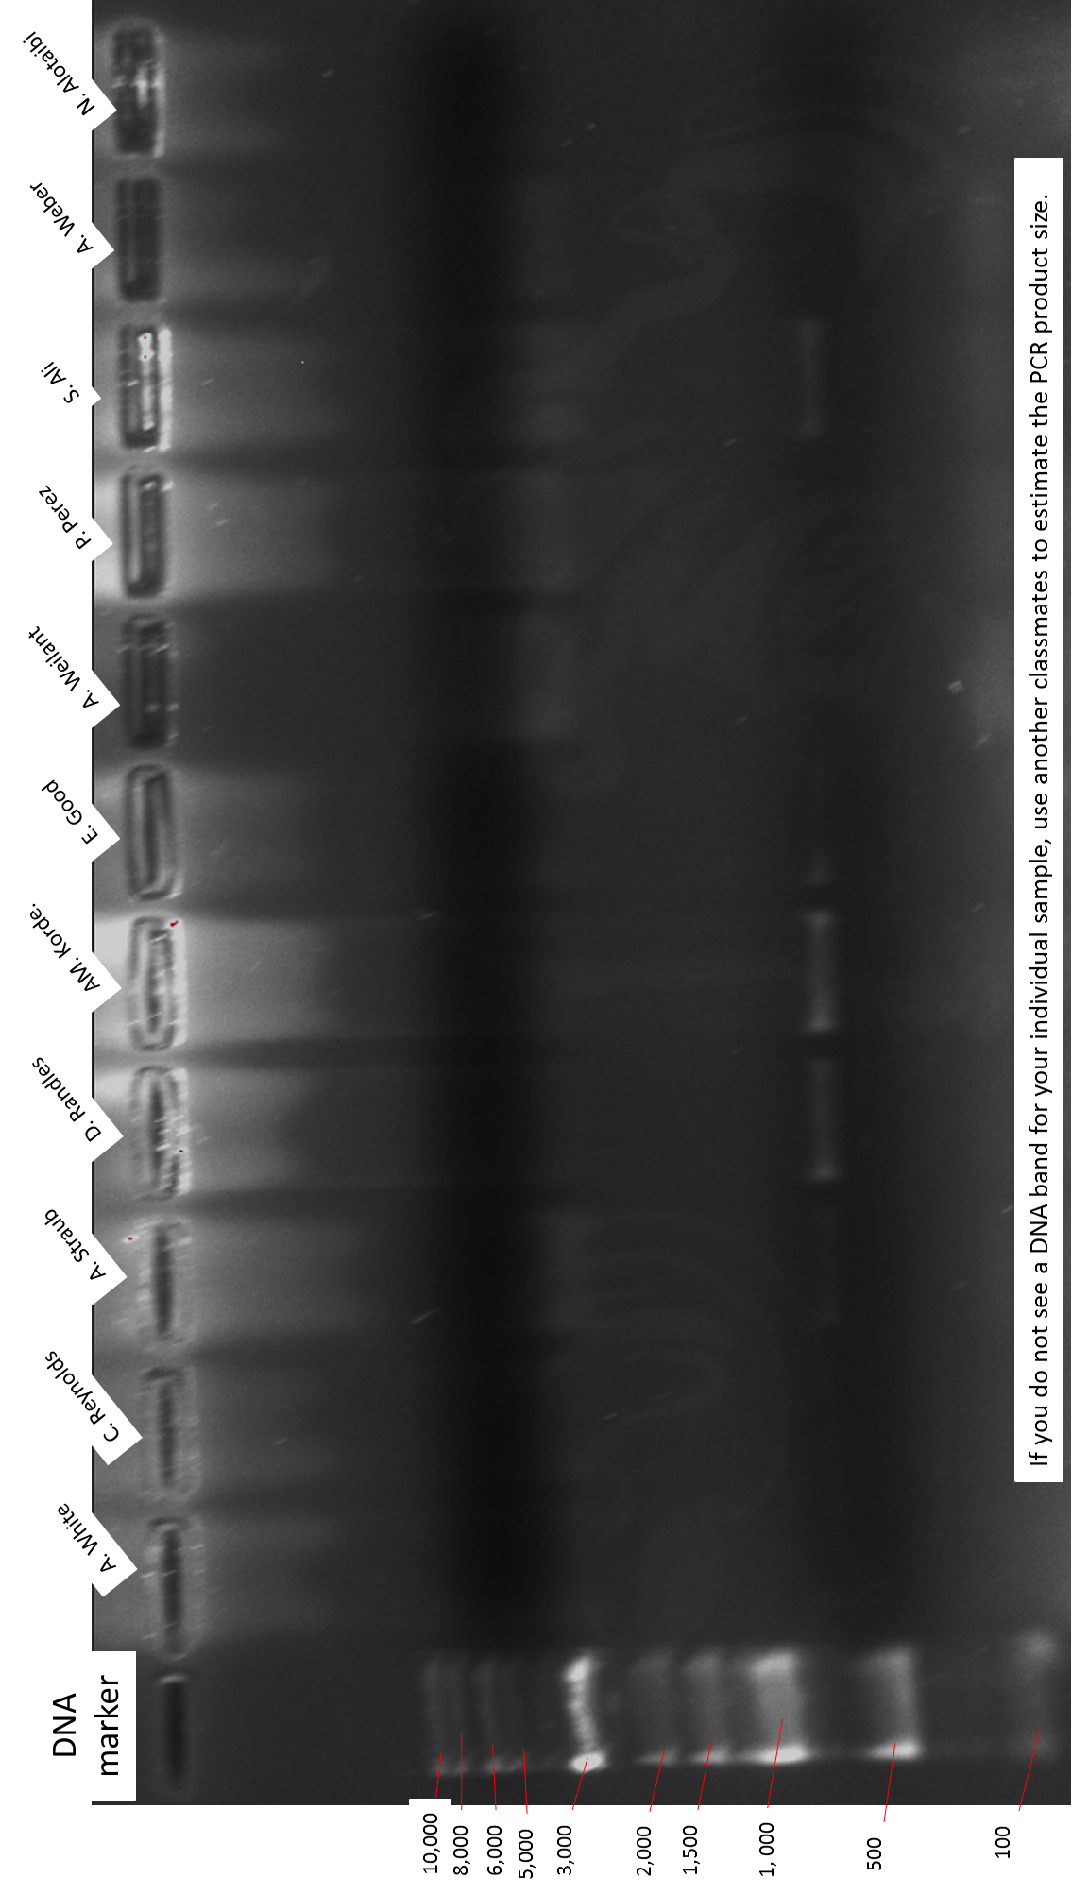

Slide 3
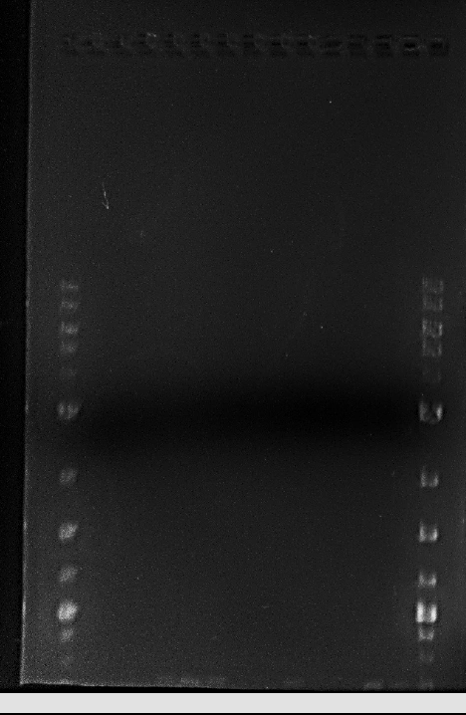
Lane 1: DNA Marker
2. A. White
3. C. Reynolds
4. A. Straub
5. D. Randles
6. AM.Kordeleski
7. E.Good
8.A. Weilant
9. P. Perez
10. S. Ali
11. A. Weber
12. N. Alotaibi
13. L. Hughes
14. N. Alnujaidi
15. DNA Marker
1 2 3 4 5 6 7 8 9 10 11 12 13 14 15
10,000
8,000
6,000
5,000
4,000
3,000
2,000
1,500
1,200
1, 000
PCR Products
900
800
700
This particular gel ran too far and the products are the faint bands at the bottom of the gel.

Slide 4
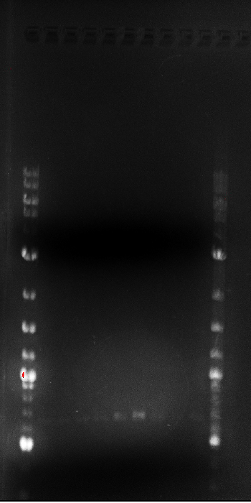
Lane 1: DNA Marker
2. M. VanDenBossche
3. T. Greathouse
4. M. DeGarmo
5. E. Powell
6. C. Wagner
7. K. Clapsaddle
8. L. Wolff
9. A. Radi
10. A. Peppers
11. DNA Marker
1 2 3 4 5 6 7 8 9 10 11
10,000
8,000
6,000
5,000
4,000
3,000
2,000
1,500
1,200
1, 000
900
PCR Product
800
700
600
500

